Slide 1
Software Team Management
Lecturer: Ngo Huy Bien
Software Engineering Department
Faculty of Information Technology
VNUHCM - University of Science
Ho Chi Minh City, Vietnam
nhbien@fit.hcmus.edu.vn

Slide 2

Objectives
To build a software team.
To manage a team.
To resolve conflicts.
To increase team productivity.
To motivate team members.
To prevent poor performance.
To lead a team.
To analyze and evaluate a management approach.

Slide 3

Contents
Software team
Team management
Conflict resolution
Team productivity
Team motivation
Team performance
Leading a team
Team evaluation

Slide 4

References
Tom DeMarco and Timothy Lister (2013). Peopleware: Productive Projects and Teams. Addison-Wesley Professional.
Frederick P. Brooks, Jr. (1995). The Mythical Man-Month: Essays on Software Engineering. Addison-Wesley Professional.
Kim Heldman (2018). PMP Project Management Professional Study Guide. John Wiley & Sons.
BW Boehm and R Ross (1989). Theory-W Software Project Management: Principles and Examples.
Douglas McGregor (1966). The Human Side of Enterprise.
Bruce W. Tuckman and Mary Ann C. Jensen (1977). Stages of Small-Group Development Revisited.
Roger S. Pressman (2010). Software Engineering: A Practitioner's Approach.
A. H. Maslow (1943). A Theory of Human Motivation.
William Holtsnider & Brian D. Jaffe (2012). IT Manager's Handbook.
Frederick Herzberg (2003). One More Time: How Do You Motivate Employees?
Tom Peters and Robert Waterman (1980). Structure Is Not Organization.

Slide 5

Why Do Projects Fail?
Unclear requirements (no problems, no business/user requirements, no communication with clients/users)
No executive summary, no project vision and scope
No stories/use cases, no mockups, no prototypes
Human factors
No feedback → No working together
No money, no challenges, no interesting works → No motivation
No estimation or incorrect estimation
Effort/Duration/Cost/Resources
No planning
No project schedule/release plan
No status reporting or incorrect status reporting
No project schedule/release plan updates
No risk management

Slide 6

What Causes Project Failures? [1]
For the overwhelming majority of the bankrupt projects, there was not a single technological issue to explain the failure.
The major problems of our work are not so much technological as sociological in nature.
The main reason we tend to focus on the technical rather than the human side of the work is not because it's more crucial, but because it's easier to do.
Peopleware can refer to anything that has to do with the role of people in the development or use of computer software and hardware systems, including such issues as developer productivity, teamwork, group dynamics, the psychology of programming, project management, organizational factors, human interface design, and human-machine-interaction.

Slide 7

Why a Team?

Slide 8
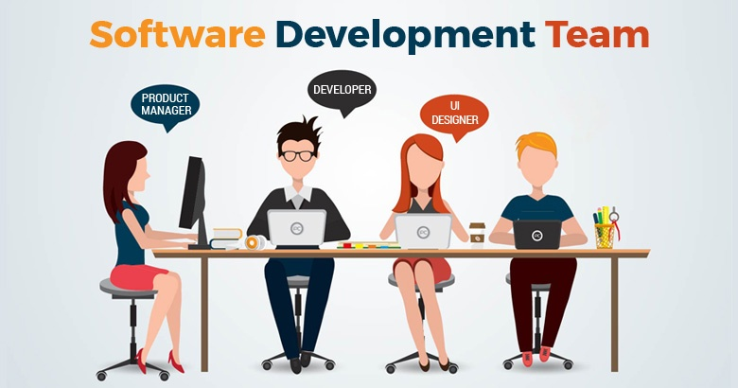
Software Team Formation
Managers
Recruit team members, or work with the functional managers.
Analyze the skills, experience and competencies within your team, and start matching people to roles.
Software engineers
Carefully review a company or a team before deciding to join them.
Fully understand what the team's role and goals are.

Slide 9

Why a Project Manager/Leader?

Slide 10


Project Manager/Leader Selection

Slide 11
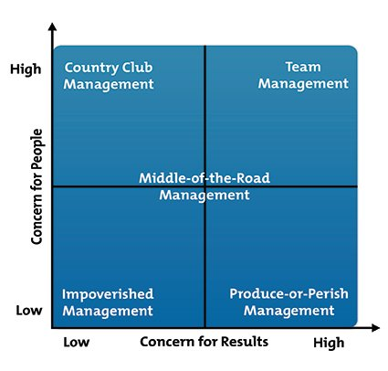
The Leadership Grid
The Leadership Grid is a model of behavioral leadership developed in the 1960s by Robert Blake and Jane Mouton to measure concern for production against concern for people.
The grid identifies five types of leaders: Impoverished, Produce or Perish, Middle of the Road, Country Club, and Team.
The Team approach is considered the most effective form of leadership, according to the creators of the Leadership Grid.

Slide 12


Project Manager/Leader's Time
Technical Issues: 20%
Human Dynamics Issues: 80%

Slide 13


Slide 14

Team Kick-off: Discussion Questions
Team building video or pictures?
Decision-making process?
Demonstration of communication plan and tools → Producing a tangible result (Google Docs).
Meeting minutes of a meeting?

Slide 15

Kick-off Meeting
Introduce team members.
Clarify the project terminologies, problems, solution, and deliverables.
Clarify RACI matrix.
Answer questions.
Start developing the project plan.

Slide 16

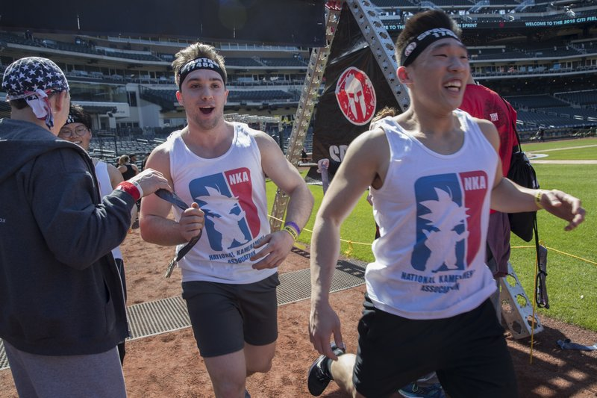

Icebreakers

Slide 17
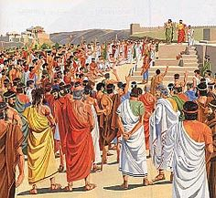
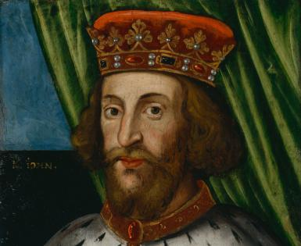
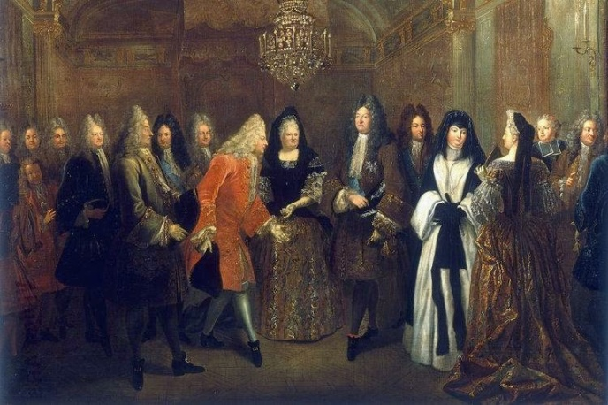
How to Reach a Decision [2]
Won't one get a better product (system design) by getting the good ideas from all the team, following a democratic philosophy, rather than by restricting the development of specifications to a few?
The conceptual integrity of a system determines its ease of use.
Monarch
Aristocracy
Democracy

Slide 18

How to Share a Work
Each segment of a large job is tackled by a team, but that the team be organized like a surgical team rather than a hog-butchering team.
That is, instead of each member cutting away on the problem, one does the cutting and the others give him every support that will enhance his effectiveness and productivity.
The Surgical Team

Slide 19
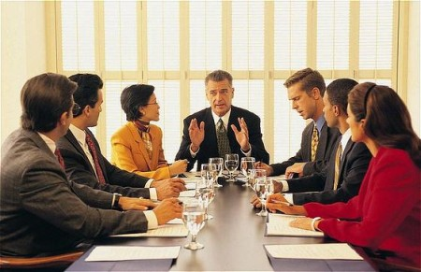
How to Conduct a Meeting?
Target
Solving problems?
Making decisions?
Transferring knowledge, getting feedback, reporting?
Responsibilities
Chairman
Secretary
Attendees
Agenda preparation
Timeframe preparation
Content, data preparation
Meeting minutes
Who were present?
What are the targets?
What are the decisions, resolutions?
Who are responsible for doing the tasks?
When will decisions be effective?

Slide 21


How to Manage a Team?

Slide 22
Management Styles: Discussion Questions
Organizational structure?
What is theory X, Y, Z?
Team leader: How to apply theory X, Y, Z?
Why know about theory X, Y, Z?
Team rules (guidelines for standard behavior) and policies (responses to specific problems)? Working hours agreement?
Task assignment and results approval procedure?
Change control process?

Slide 23
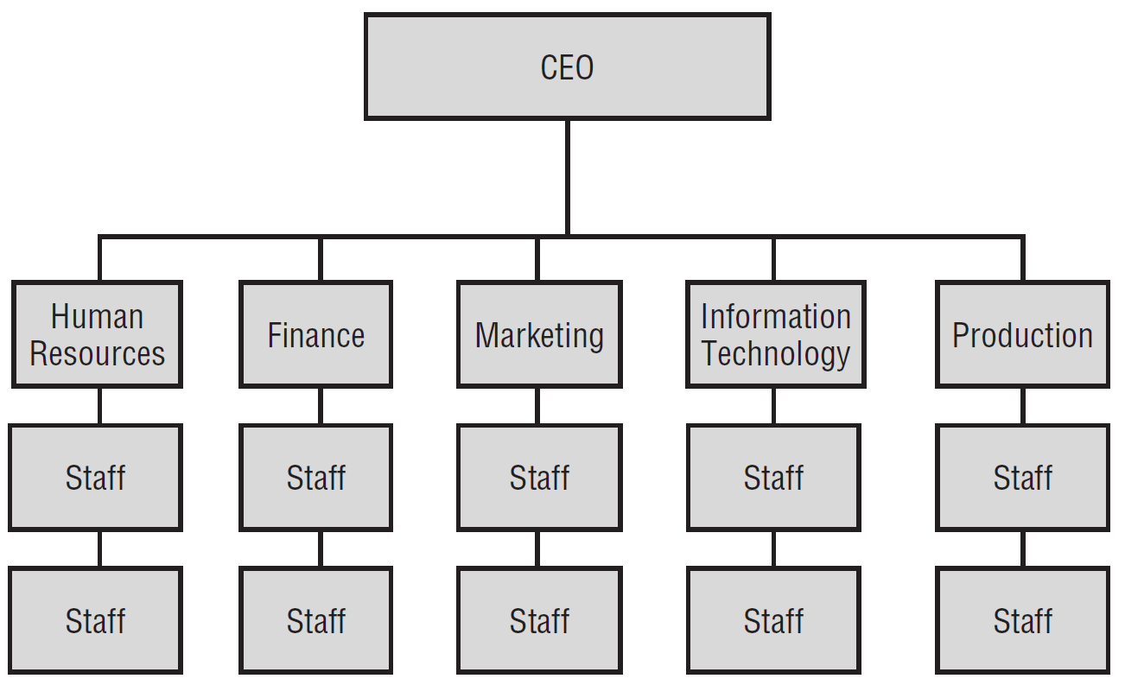
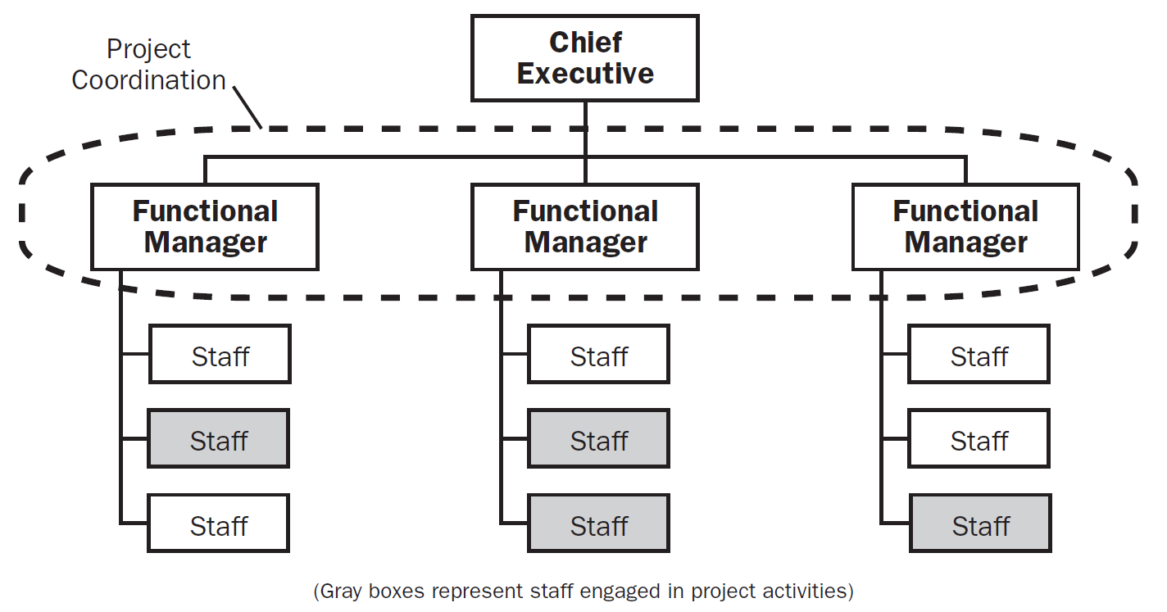
Functional Organizations [3]
Functional organizations are centered on specialties and grouped by function, hence the term functional organization.
Notes:
The classic functional organization is a hierarchy where each employee has one clear superior.
Each department in a functional organization will do its project work independently of other departments.

Slide 24
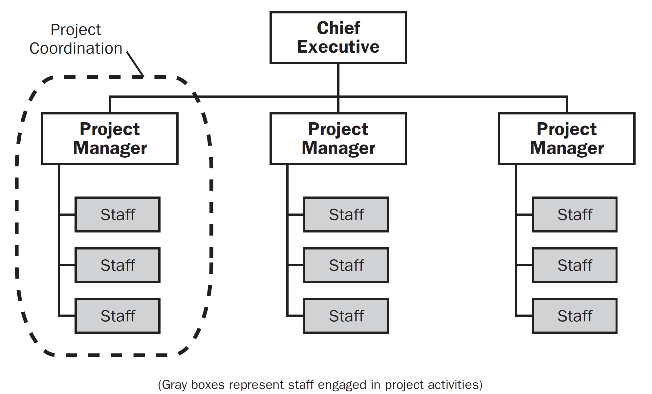
Projectized Organizations
Notes:
Most of the organization's resources are involved in project work, and project managers have a great deal of independence and authority.

Slide 25
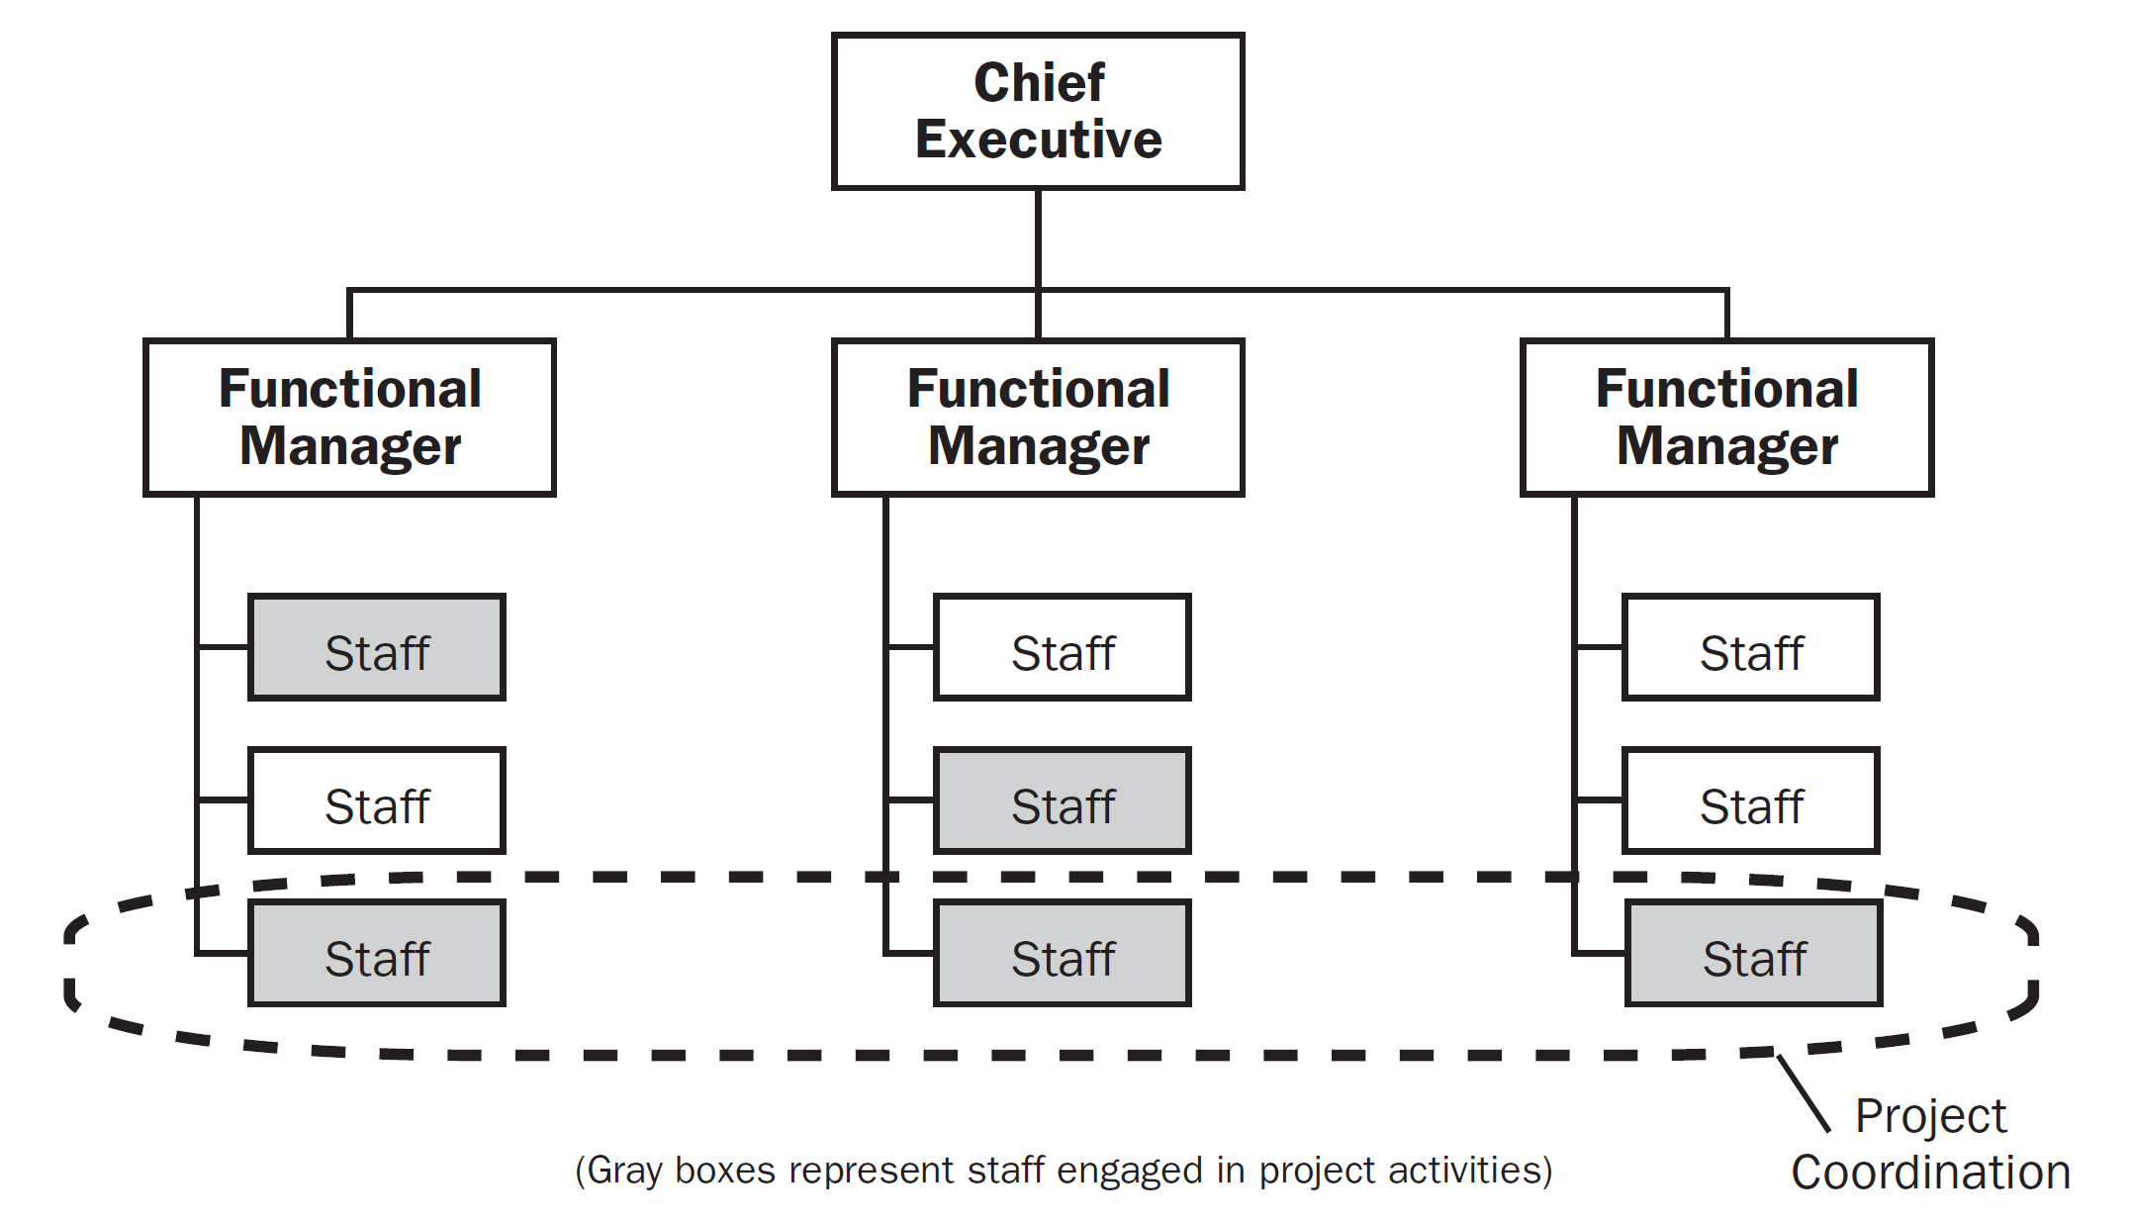
Weak Matrix Organization
Notes:
Weak matrix organizations maintain many of the characteristics of a functional organization, and the role of the project manager is more of a coordinator or expediter.
A project expediter works as staff assistant and communications coordinator.
Project coordinators have power to make some decisions, have some authority, and report to a higher-level manager.

Slide 26
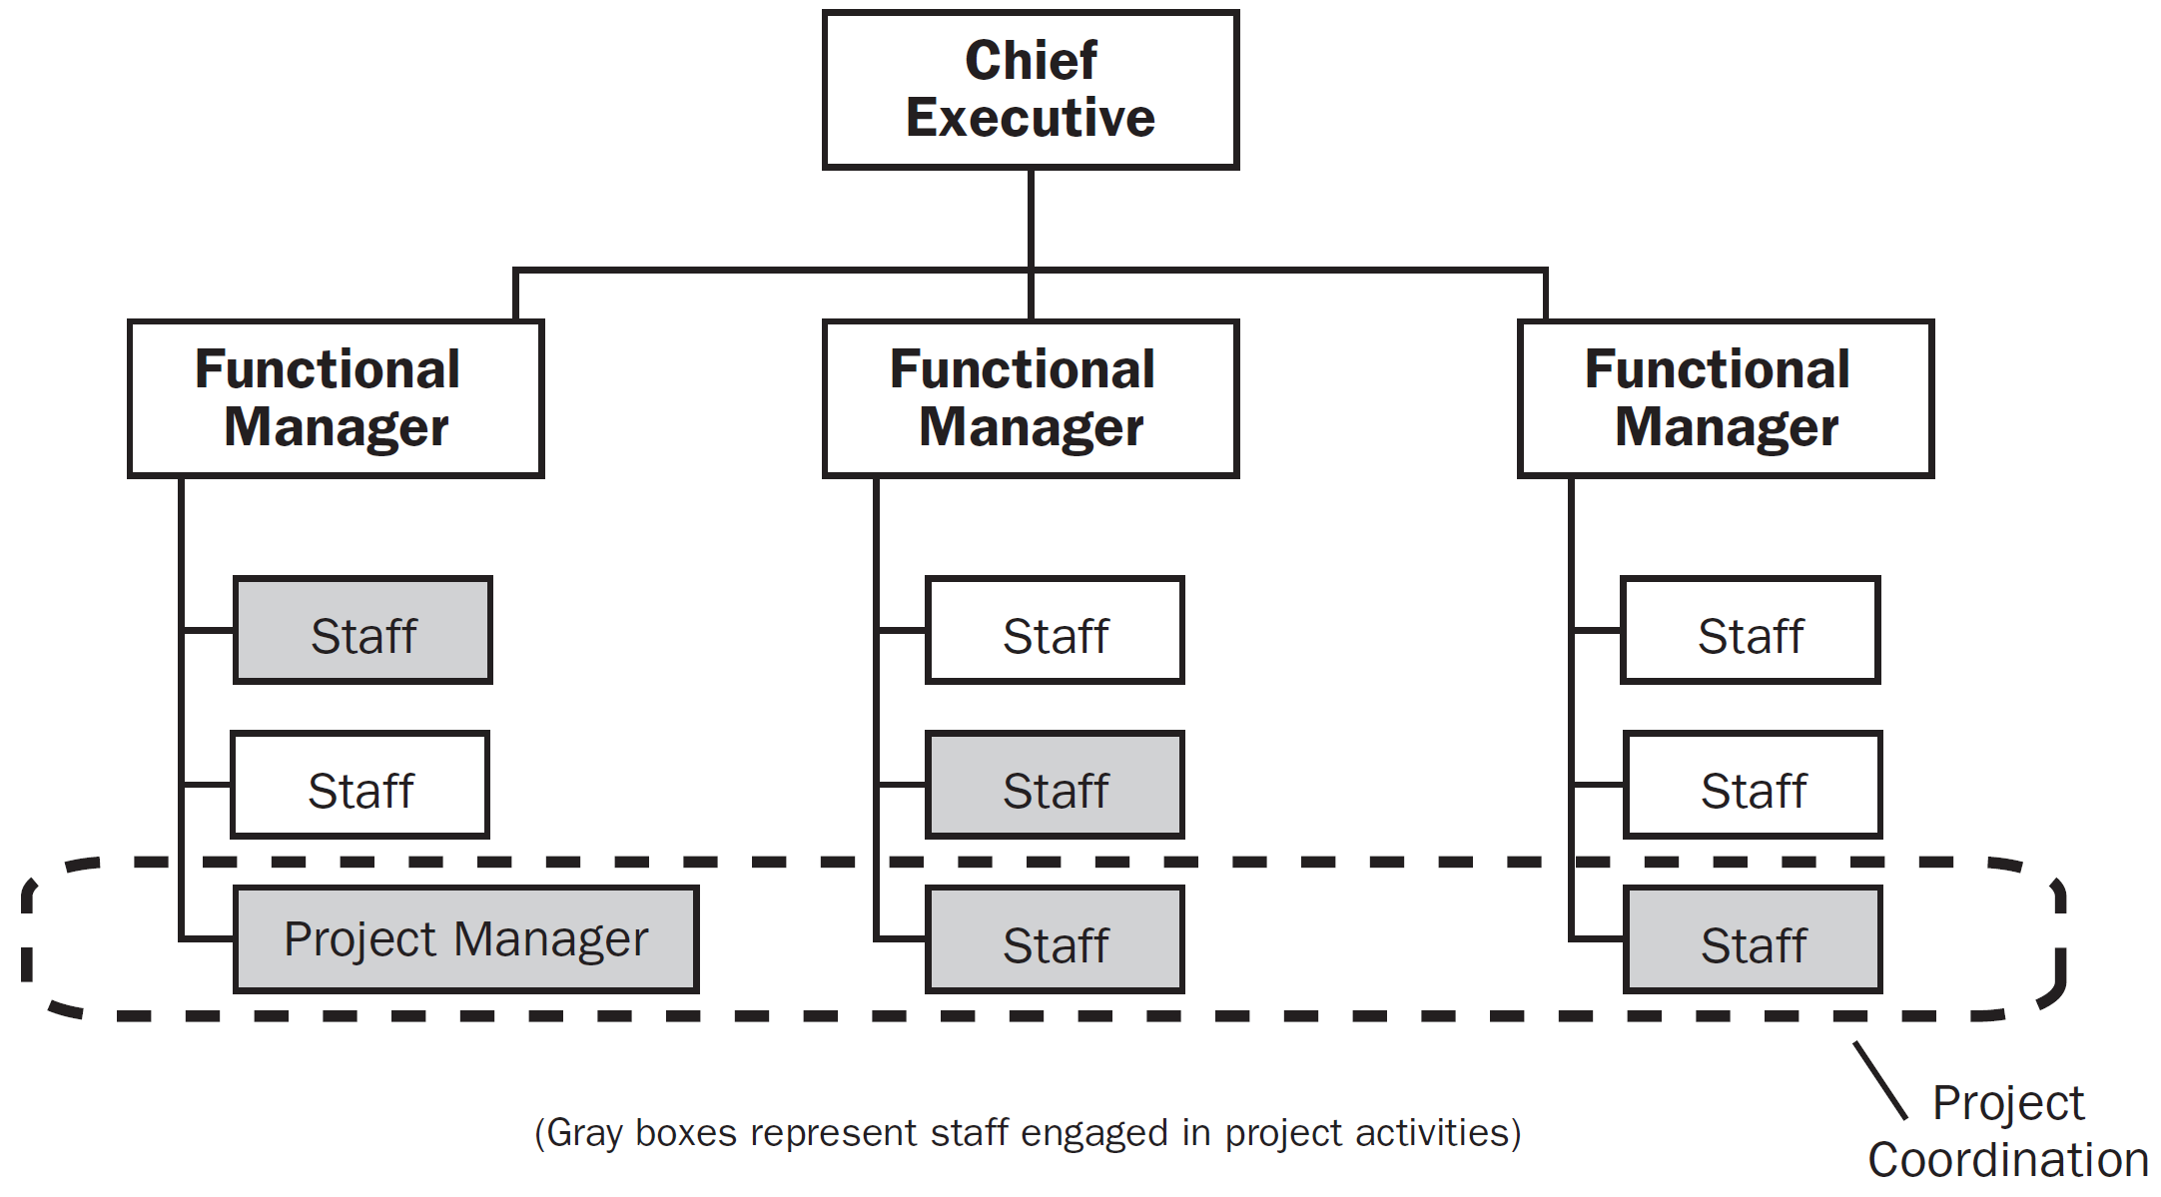
Balanced Matrix Organization
Notes:
While the balanced matrix organization recognizes the need for a project manager, it does not provide the project manager with the full authority over the project and project funding.

Slide 27
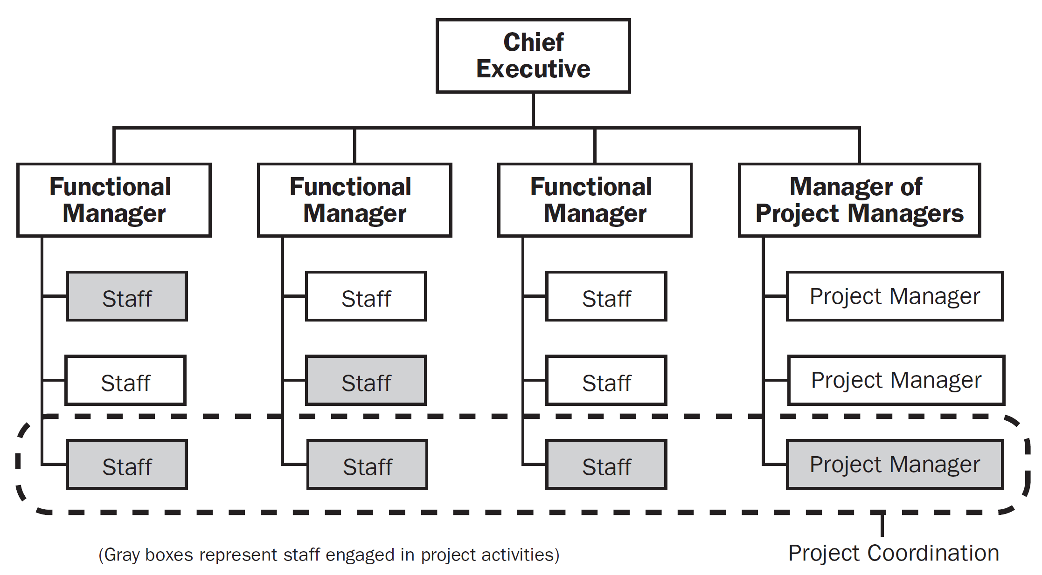
Strong Matrix Organization
Notes:
Strong matrix organizations have many of the characteristics of the projectized organization, and have full-time project managers with considerable authority and full-time project administrative staff.

Slide 28
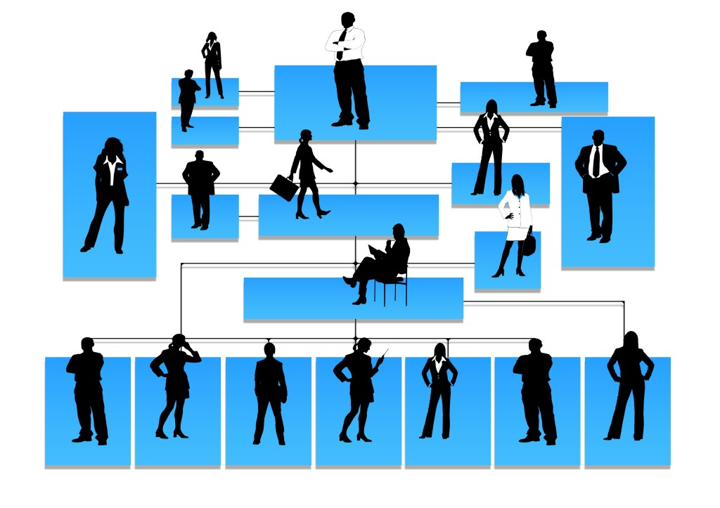
Why Understand Organizational Structure?

Slide 29

Answer
Organizational structure is an enterprise environmental factor, which can affect the availability of resources and influence how projects are conducted.
Understanding the organizational structure will help you, as a project manager, with the cultural influences and communication avenues that exist in the organization to gain cooperation and successfully bring your projects to a close.

Slide 30
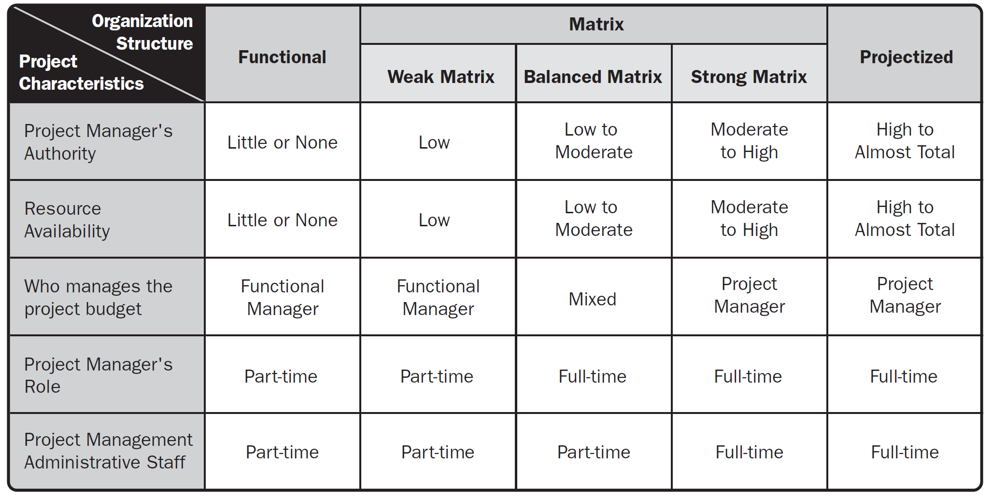
Influence of Organizational Structures on Projects

Slide 32
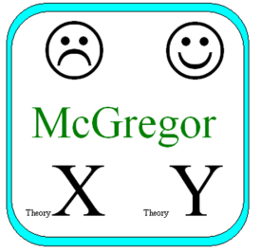
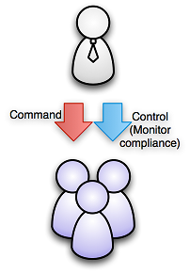
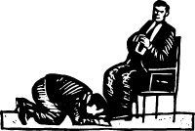
Theory X [4]
People don't like to work.
People are irresponsible.
People prefer to be controlled, directed.
Theory X held that the most efficient way to get a job done was to do more and more precise time and motion studies, and to organize jobs into well-orchestrated sequences of tasks in which people were as efficient and predictable as machines.
Management consisted of keeping the system running smoothly, largely through coercion.
The Theory X was a poor long-term strategy because it stunted people's creativity, adaptiveness, and self esteem, making the people and their organizations unable to cope with change.

Slide 33
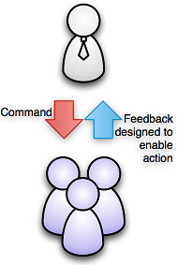

Theory Y [4, 5]
People like to work if conditions are favorable.
People are responsible.
People can be self directed, creative at work if properly motivated.
This is a process primarily of creating opportunities, releasing potential, removing obstacles, encouraging growth, providing guidance.
Theory Y created difficulties in dealing with conflict. This became a major concern in Theory Y organizations, with many individual initiatives competing for resources and creating problems of coordination.

Slide 34

From Theory X to Theory Y [5]
Theory X places exclusive reliance upon external control of human behavior, whereas Theory Y relies heavily on self-control and self-direction.
These are ways of freeing people from the too-close control of conventional organization, giving them a degree of freedom to direct their own activities, to assume responsibility, and importantly, to satisfy their egoistic needs.

Slide 35
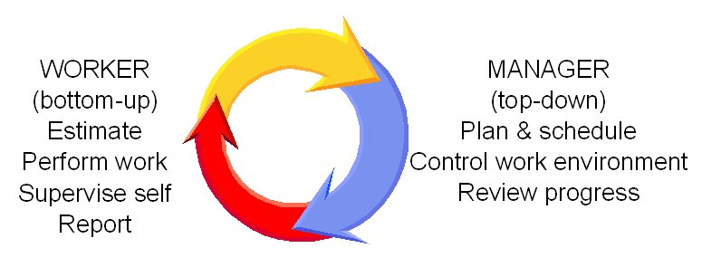
Theory Z
Theory Z holds that much of the conflict resolution problem can be eliminated by up-front investment in developing shared values and arriving at major decisions by consensus.

Slide 36

William Ouchi's Theory Z (I)
A strong company philosophy and culture: The company philosophy and culture needs to be understood and embodied by all employees, and employees need to believe in the work they're doing.
Long-term staff development and employment: The organization and management team has measures and programs in place to develop employees. Employment is usually long-term, and promotion is steady and measured. This leads to loyalty from team members.
Concern for the happiness and well-being of workers: The organization shows sincere concern for the health and happiness of its employees, and for their families. It puts measures and programs in place to help foster this happiness and well-being.

Slide 37
William Ouchi's Theory Z (II)
Consensus in decisions: Employees are encouraged and expected to take part in organizational decisions.
Generalist employees: Because employees have a greater responsibility in making decisions, and understand all aspects of the organization, they should be "generalists." However, employees are still expected to have specialized career responsibilities.
Informal control with formalized measures: Employees are empowered to perform tasks the way they see fit, and management is quite "hands off." However, there should be formalized measures in place to assess work quality and performance.
Individual responsibility: The organization recognizes the contributions of individuals, but always within the context of the team as a whole.

Slide 38
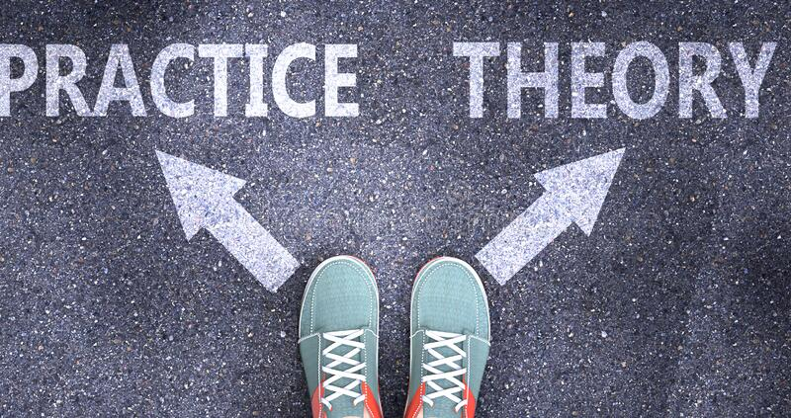
William Ouchi's Theory Z (III)
It can be impractical to use all elements of the theory.
However, it still has many useful strategies, which you can use to boost your team's performance and productivity.

Slide 39

Key Person [1]
Isn't that the essence of management, after all, to make sure that the work goes on whether the individuals stay or not?
So why don't we have a key person?

Slide 40


A Quota for Errors
Fostering an atmosphere that doesn't allow for error simply makes people defensive.
They don't try things that may turn out badly.

Slide 41

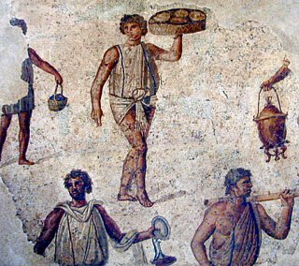
Management: The Bozo Definition
Management is kicking ass.
Managers provide all the thinking and the people underneath them just carry out their bidding.
You may be able to kick people to make them active, but not to make them creative, inventive, and thoughtful.

Slide 42
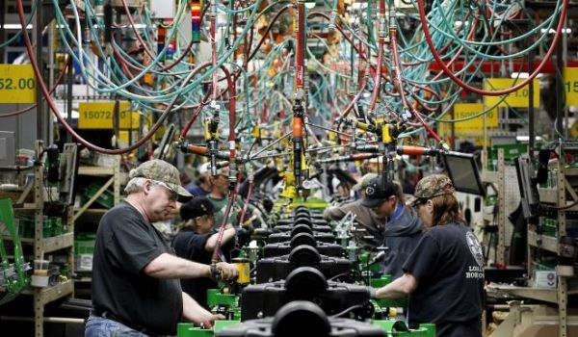
The People Store
Think of people as parts of the machine.
When a part wears out, you get another.

Slide 43
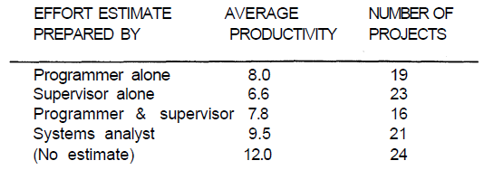
Parkinson's Law
Parkinson's law: Work expands to fill the time allocated for it.
Organizational busy work tends to expand to fill the working day.
The only way to get work done at all is to set an impossibly optimistic delivery date.
Parkinson's law almost certainly doesn't apply to your development workers. Why?

Slide 44
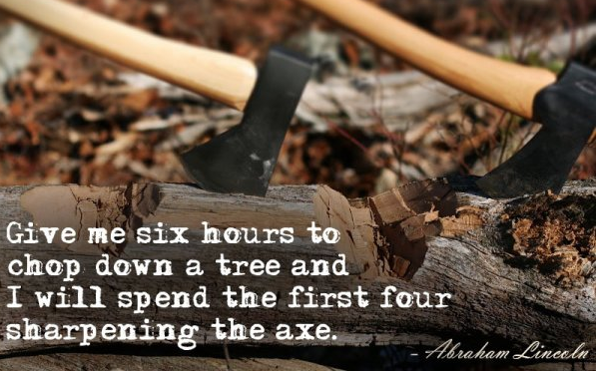
Reserve Time for Thinking
We haven't got time to think about this task, only to do it.
What proportion of your time ought to be dedicated to actually doing a task?

Slide 46
Conflicts: Discussion Questions
Why learn about team development?
What is the most important stage of team development? What should we do at this stage?
List of your team conflicts? Conflict resolution techniques?
Lessons learned?

Slide 47

Example Conflicts
Tools (GIT vs. SVN, Wrike vs. Jira)
Development process (which files should be put into source control, broken code, different code structure, compilation errors, errors when following compilation guide, need of mockups)
Coding standards (long methods, variable names)
Templates (use cases, user stories, test cases)
Progress tracking (task status, time log)

Slide 48
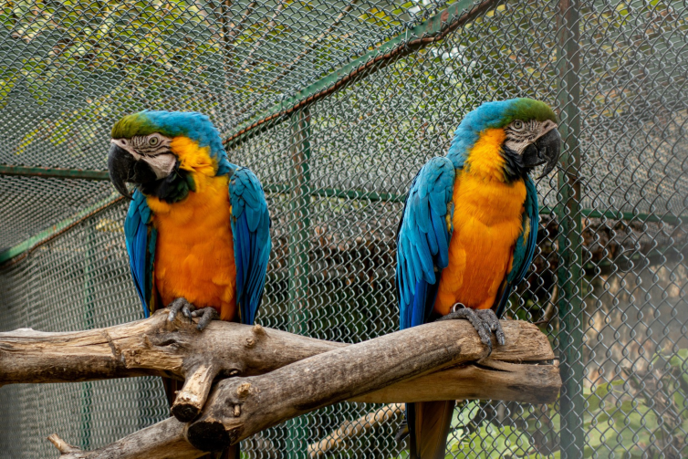
Conflict is Not a Decision
A conflict cannot always be resolved merely by making a decision.
A decision may settle what happens next, while the underlying disagreement may remain.

Slide 49
When Do We Get Conflicted? [6]
Celebrate its achievements.
Forming
Storming
Norming
Performing
Adjourning
Help the team take responsibility for progress towards the goal.
Establish process and structure
Work to smooth conflict
Build good relationships between team members.
Delegate as far as you sensibly can.
Aim to have as "light a touch" as possible.
Establish objectives clearly.

Slide 50

Why Do We Get Conflicted? (I)
No leader, lack of reputation

Slide 51



Why Do We Get Conflicted? (II)
Formal meeting
Informal meeting
Phone call
Paper report
Conference call
Email
Instant messages
Project management software
No Communication!

Slide 52


Forms of Communication [3]
Verbal communication is easier and less complicated than written communication, and it's usually a fast method of communication.
Written communication, on the other hand, is an excellent way to get across complex, detailed messages.
Horizontal communications are messages sent and received to peers.
Vertical communications are messages sent and received down to subordinates and up to executive management.

Slide 53

Face to Face Communication
Body language.
Tone of voice.

Slide 54
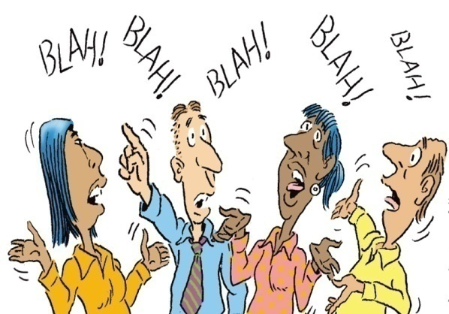

Why Can't We Communicate? [7]
Principle 1. Listen.
Principle 2. Prepare before you communicate.
Principle 3. Someone should facilitate the activity.
Principle 4. Face-to-face communication is best.
Principle 5. Take notes and document decisions.
Principle 6. Strive for collaboration.
Principle 7. Stay focused; modularize your discussion.
Principle 8. If something is unclear, draw a picture.
Principle 9. (a) Once you agree to something, move on. (b) If you can't agree to something, move on. (c) If a feature or function is unclear and cannot be clarified at the moment, move on.
Principle 10. Negotiation is not a contest or a game. It works best when both parties win.

Slide 55


Barriers to Effective Listening
Considering that the subject is uninteresting
Evaluating the speaker, not the subject
Becoming emotionally involved
Listening for facts, not central ideas
Avoiding difficult topics
Too much note taking

Slide 56
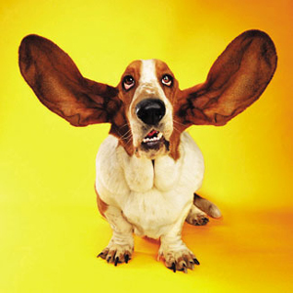

Active Listening
Look at the speaker directly
Minimize external distractions
Minimize internal distractions
Nod occasionally, Murmur (“uh-huh” and “um-hmm”)
Summarize the speaker's comments periodically
Note unclear information, disagreement
Allow the speaker to finish
Ask questions for clarification

Slide 57
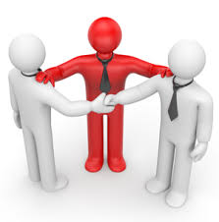
Conflict Management Techniques [3]
Withdraw/Avoid. One of the parties gets up and leaves and refuses to discuss the conflict. When parties withdraw or avoid, they never reach resolution.
Smooth/Accommodate. The areas of agreement are emphasized over the areas of difference. Someone attempts to make the conflict appear less important than it is. The smooth or accommodate technique does not lead to a permanent solution.
Force/Direct. One person forces a solution on the other parties. Although this is a permanent solution, it isn't necessarily the best solution.
Compromise/Reconcile. Each of the parties involved in the conflict gives up something to reach a solution.
Collaborate/Problem Solve. A fact-finding mission. Once the facts are uncovered, they're presented to the parties and the decision will be clear. Collaborating will lead to true consensus.

Slide 58
Division of Responsibilities and Value Conflicts
Between 2 members.
Among groups.

Slide 59


Members' Conflict
Conduct one-to-one meetings with each party.
Review the goals, commitments, and policies.
Every one-on-one meeting should conclude with action items.
All parties are held accountable for deliverables.
If they aren't, ask what obstacles are preventing action and try to help them resolve the issue.

Slide 60

Intergroup Conflicts
Review the motivation and goals of each group.
Review the policies and rules.
Review the bases of power: coercive power, legitimate power, reward power, referent power and expert power.
Definition of justice, injustice and life meaning.

Slide 61

Reasoned Discussions and Explanations

Slide 62


The Struggle for Recognition

Slide 64
Productivity: Discussion Questions
What is the Spanish theory?
Overtime agreement?
What is the English theory?
Tools used for improving productivity?

Slide 65
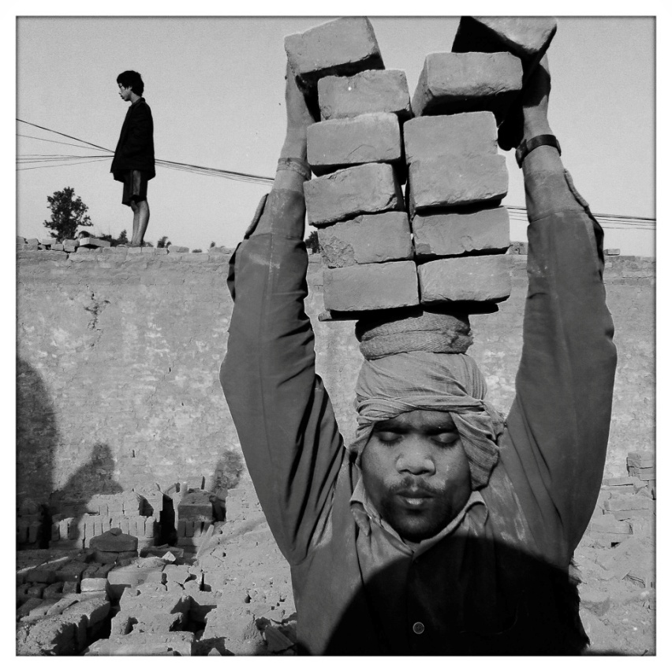
How to Increase Team Productivity
Productivity ought to mean achieving more in an hour of work, but all too often it has come to mean extracting more for an hour of pay.
The Spanish Theory: only a fixed amount of value existed on earth, and therefore the path to the accumulation of wealth was to learn to extract it more efficiently from the soil or from people's backs.

Slide 66

Overtime is Like Sprinting
It makes some sense for the last hundred yards of the marathon for those with any energy left, but if you start sprinting in the first mile, you're just wasting time.

Slide 67

Force People Working Overtime
Trying to get people to sprint too much can only result in loss of respect for the manager.
The best workers take their compensatory under time when they can, and end up putting in forty hours of real work each week.
People under time pressure don't work better; they just work faster.
In order to work faster, they may have to sacrifice the quality of the product and their own job satisfaction.
Overtime for salaried workers is a figment of the naive manager's imagination.

Slide 68


Vienna Waits for You
“Work longer and harder”
Your people are very aware of the one short life that each person is allotted.
And they know too well that there has got to be something more important than the silly job they're working on.

Slide 69

The English Theory
Value could be created through ingenuity and technology.

Slide 71
Motivation: Discussion Questions
What is Maslow's hierarchy of needs?
Why learn about Maslow's hierarchy of needs?
Benefits agreement? Learning opportunities? Career path?

Slide 72
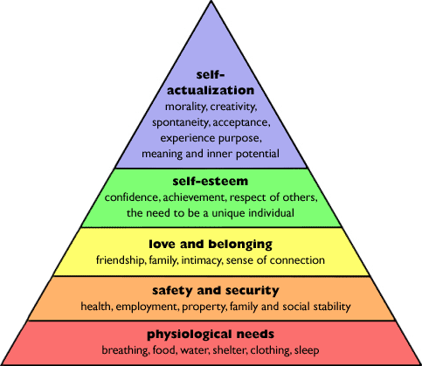




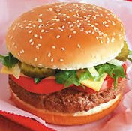
Maslow's Hierarchy of Needs [8]
They can seek knowledge, peace, esthetic experiences, self-fulfillment, oneness with God, etc.
Obtaining our full potential; becoming confident, eager to express our beliefs, and willing to reach out to others to help them
Thrive
Without these people will not act civilly.
------------------
Survive
---------------
Alive
------------
Dead
Extrinsic Motivation
Necessary for life; unmet, these needs lead to death

Slide 73
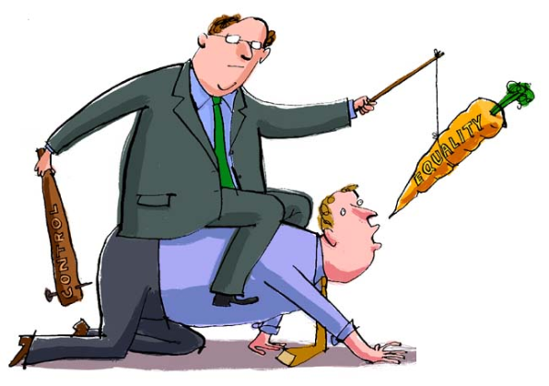
The Carrot and Stick Approach [9]
The means for satisfying man's physiological and (within limits) his safety needs can be provided or withheld by management.
Employment itself is such a means, and so are wages, working conditions, and benefits. By these means the individual can be controlled so long as he is struggling for subsistence. Man lives for bread alone when there is no bread.

Slide 74

When to Use?
But the carrot and stick theory does not work at all once man has reached an adequate subsistence level and is motivated primarily by higher needs.

Slide 75

What Can You Do?
They can seek knowledge, peace, esthetic experiences, self-fulfillment, oneness with God, etc.
Obtaining our full potential; becoming confident, eager to express our beliefs, and willing to reach out to others to help them
Nothing
--------------------------------
Leadership
----------------------------
Leadership
Without these people will not act civilly.
------------------------
Company
---------------------
Company
------------------
Nothing
Extrinsic Motivation
Necessary for life; unmet, these needs lead to death

Slide 77
Performance: Discussion Questions
Commitment agreement?
Tasks management system?
Timesheet management system?
Training?
Tools for tracking KPIs?

Slide 78

Prevent Poor Performance
Ensure that the task assignee knows
why her task is important,
what she need to do and deliver,
when she need to submit her result,
which support she needs.

Slide 79
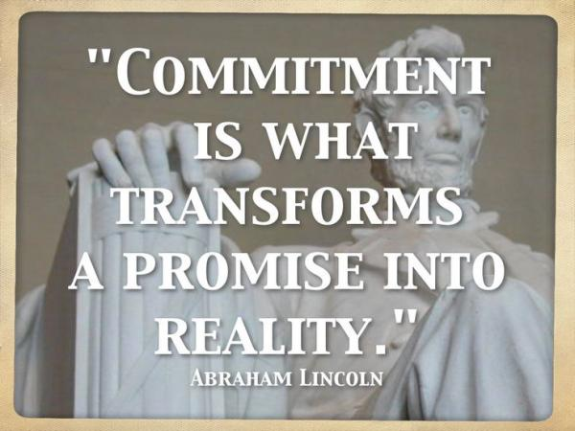
1. Ask for Commitment
People commit to a group or organization because they gain something important from their involvement.
Be open and clear about the mission, principles, and goals of your team.
Pick out the right level of challenge for people.

Slide 80
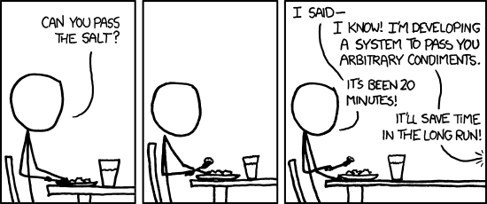
2. Prevent the Second-System Effect [2]
The general tendency is to over-design the second system, using all the ideas and frills that were cautiously sidetracked on the first one.
Be conscious of the peculiar hazards of that system, and exert extra self-discipline to avoid functional ornamentation and to avoid extrapolation of functions that are obviated by changes in assumptions and purposes.

Slide 81

3. Provide Training [9]
Cost
Need
Employee morale
Scheduling demands
Certification
What if the employee takes a training class and then uses his new-found skills to find another job? – Employee agreements
Maximizing the value of training (transferring knowledge)

Slide 82
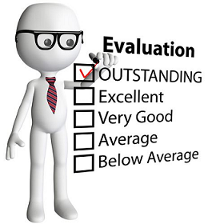
4. Perform Performance Reviews
Quality of work
Flexibility
Creativity in solving problems
Communication skills
Innovation
Going above and beyond the requirements of the job
Coordination, interaction, and collaboration with others (particularly those they don't have direct authority over)
Accountability
Ability to complete assignments in a timely manner
Ethics and compliance
Ability to pick up new skills on their own
Ability to work with and enhance the work of other staff members
Ability to manage short- and long-term projects

Slide 83

5. Solve Performance Problem
Lack of Resource
Lack of Motivation
Lack of Skills
Make sure people have materials and training
Help people establish performance goals make sure people have the tools, resources
Show positive things and people
Help people focus on past success, strengths, rewards
Help people focus on work
Rewards and discipline are clearly linked to performance and defined behavioral objectives.

Slide 84

6. Try Seven Step Feedback Model
When you…
I feel…
Because…
Pause for a response (Optional)
What I would like is…
Because…
What do you think?

Slide 85
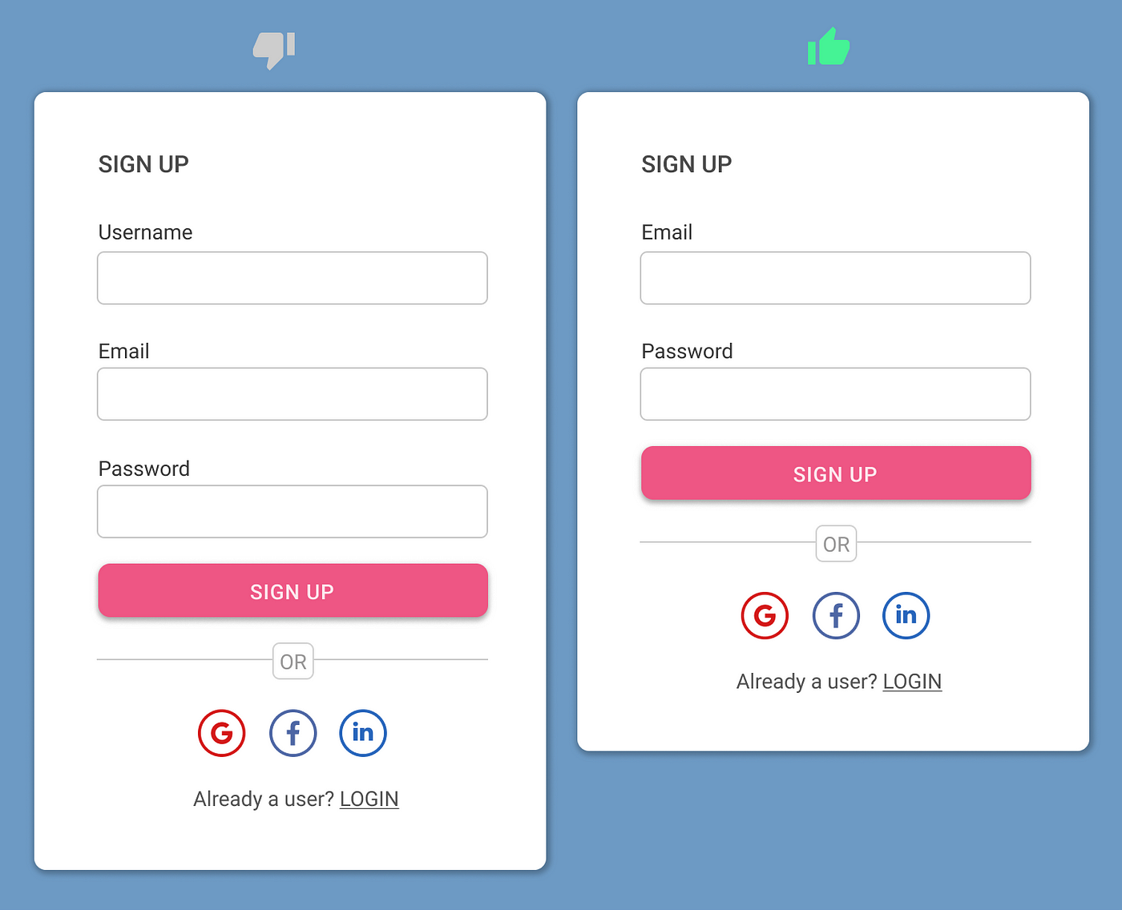
7. Make Agreement: Done Looks Like This

Slide 86

8. Build Consistency
Consistency throughout the project in how things are done.
Consistency in how the project integrates with and adheres to organizational processes, procedures, guidelines, and policies.

Slide 87

9. Build Consensus
As it is within the team, listening to all viewpoints and building consensus on which is the best idea or action that will help the project move forward is also important to stakeholders.

Slide 88
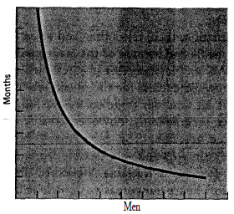
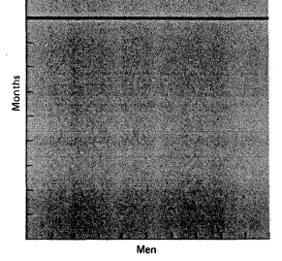
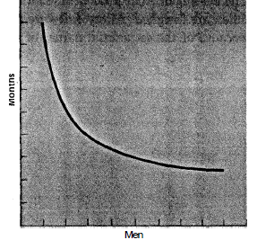
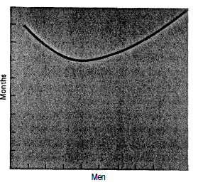
The Mythical Man-Month
Adding manpower to a late software project makes it later.
Perfectly partition-able task
Unpartition-able task
Partition-able task requiring communication
Task with complex interrelation-ships

Slide 90
Leadership: Discussion Questions
Intrinsic rewards (recognition, responsibility, advancement)?
Achievement?
Power?
Affiliation?

Slide 91

Intrinsic Motivation [10]
Forget praise. Forget punishment. Forget cash.
You need to make their jobs more interesting.
Most of us are motivated by intrinsic rewards: interesting, challenging work, and the opportunity to achieve and grow into greater responsibility.
Of course, you have to provide some extrinsic incentives.
After all, few of us can afford to work for no salary.

Slide 92

Intrinsic Rewards
Enrich their jobs by applying these principles:
Enable people to take on new, more difficult tasks they haven't handled before.
Assign individuals specialized tasks that allow them to become experts.
Increase individuals' accountability for their work by removing some controls.
Make information available directly to employees rather than sending it through their managers first.
Give people responsibility for a complete process or unit of work.

Slide 93
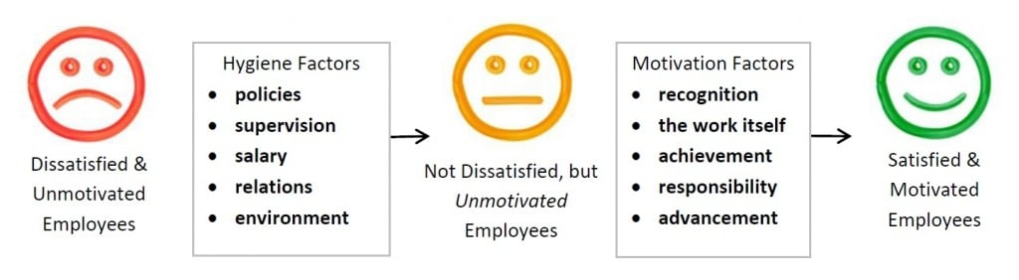
Hygiene Theory (Frederick Herzberg) [3]
There are two factors that contribute to motivation: hygiene factors and motivators.
Hygiene factors deal with work environment issues. They prevent dissatisfaction: Pay, benefits, the conditions of the work environment, and relationships with peers and managers.
Motivators deal with the substance of the work itself and the satisfaction one derives from performing the functions of the job. Motivators lead to satisfaction: The ability to advance, the opportunity to learn new skills, and the challenges involved in the work.

Slide 94


Expectancy Theory (Victor Vroom)
The expectation of a positive outcome drives motivation.
People will behave in certain ways if they think there will be good rewards for doing so.
This theory also says that people become what you expect of them.
Treat people like valuable contributors.
Never criticize people in public.

Slide 95

Coach by Encouragement
The purpose of coaching is to redirect behavior and mentally challenge the trainee.
Coaching is not intended to "do for" the learner or point out mistakes, blame, or criticize.
Change incorrect actions or redirect the behavior:
How else might you do it?
See if this works better for you. (Be specific, explain, and demonstrate.)
Why don't you try a different approach?
Let me offer a suggestion.
What happens if you don't do that step?

Slide 96
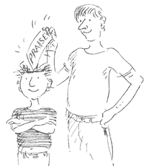
Give Encouraging Feedback
The purpose of feedback is to build self-esteem through encouragement.
Feedback should be specific, positive, and focused on the strengths and assets of the trainee; it should demonstrate acceptance of and confidence in the trainee; and it should recognize effort and improvement.
It usually takes a couple of practice sessions to master that step. You'll make it!
Look how much better it went this time.
You're making progress. Hang in there!
You're really skilled in.................. (something specific)
You must feel good about the improvement you've made.
You have put a lot of effort into mastering that task.

Slide 97

Achievement Theory (David McClelland)
Achievement theory says that people are motivated by the need for three things: achievement, power, and affiliation.
The achievement motivation is obviously the need to achieve or succeed.
The power motivation involves a desire for influencing the behavior of others.
And the need for affiliation is relationship oriented.

Slide 99
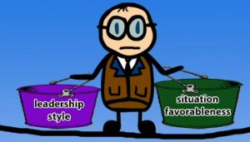
Contingency Theory (Fred Fiedler)
Fred Edward Fiedler (1967). Theory of Leadership Effectiveness. McGraw-Hill Education.
No single leadership style is perfect or ideal, as the needs change depending on circumstances and context.
A leader's effectiveness is based on the situation.
This is the result of two factors – "leadership style" and "situational favorableness" (later called "situational control").

Slide 100

Least-Preferred Coworker Scale
The least preferred coworker (LPC) scale requires a person to rate the one individual they would least want to work with — the least-preferred coworker — using a range of 18 to 25 bipolar (positive or negative) adjectives, with ratings from 1 to 8.
The scale utilizes a subjective evaluation of an individual's attitudes toward their least favorable coworker.
Unfriendly | 1 2 3 4 5 6 7 8 | Friendly
Unpleasant | 1 2 3 4 5 6 7 8 | Pleasant
Rejecting | 1 2 3 4 5 6 7 8 | Accepting

Slide 101
Example LPC Scale
Unfriendly | 1 2 3 4 5 6 7 8 | Friendly
Unpleasant | 1 2 3 4 5 6 7 8 | Pleasant
Rejecting | 1 2 3 4 5 6 7 8 | Accepting
Tense | 1 2 3 4 5 6 7 8 | Relaxed
Cold | 1 2 3 4 5 6 7 8 | Warm
Boring | 1 2 3 4 5 6 7 8 | Interesting
Backbiting | 1 2 3 4 5 6 7 8 | Loyal
Uncooperative | 1 2 3 4 5 6 7 8 | Cooperative
Hostile | 1 2 3 4 5 6 7 8 | Supportive
Guarded | 1 2 3 4 5 6 7 8 | Open
Insincere | 1 2 3 4 5 6 7 8 | Sincere
Unkind | 1 2 3 4 5 6 7 8 | Kind
Inconsiderate | 1 2 3 4 5 6 7 8 | Considerate
Untrustworthy | 1 2 3 4 5 6 7 8 | Trustworthy
Gloomy | 1 2 3 4 5 6 7 8 | Cheerful
Quarrelsome | 1 2 3 4 5 6 7 8 | Harmonious

Slide 102


LPC Score
Task-oriented leaders usually view their LPCs more negatively, resulting in a lower score. Low LPCs are very effective at completing tasks. They're quick to organize a group to get tasks and projects done. Relationship-building is a low priority.
Relationship-oriented leaders usually view their LPCs more positively, giving them a higher score. High LPCs focus more on personal connections, and they're good at avoiding and managing conflict. They're better able to make complex decisions.

Slide 103
Situational Favorableness
Leader-Member Relations |  | Task Structure |  | Leader's Position Power
The level of trust and confidence that your team has in you. |  | The type of task you're doing: clear and structured, or vague and unstructured. |  | The amount of power you have to direct the group, and provide reward or punishment.
Good | Poor | Structured | Unstructured | Strong | Weak

Slide 104
Most Effective Leader Style
Leader-Member Relations | Task Structure | Leader's Position Power | Most Effective Leader
Good | Structured | Strong | Low LPC
Good | Structured | Weak | Low LPC
Good | Unstructured | Strong | Low LPC
Good | Unstructured | Weak | High LPC
Poor | Structured | Strong | High LPC
Poor | Structured | Weak | High LPC
Poor | Unstructured | Strong | High LPC
Poor | Unstructured | Weak | Low LPC

Slide 105

The Power of Leaders
Punishment, also known as coercive or penalty power, is just the opposite of reward power.
Expert power occurs when the person being influenced believes the manager, or the person doing the influencing, is knowledgeable about the subject or has special abilities that make them an expert.
Legitimate, or formal, power comes about as a result of the influencer's position.
Referent power is inferred to the influencer by their subordinates.

Slide 107

Stakeholder (Sponsor) Persuasion
Liking: People will agree more often with people they like.
Take the time to build positive relationships with stakeholders.
Reciprocity: Others will do things for us if we have first done things for them.

Slide 108


Stakeholder (Sponsor) Influence
Scarcity: What you do for this stakeholder must be seen as:
Beneficial
Unique
The stakeholder must also understand what they can potentially lose.
Authority: If you are seen as not just the person with “authority,” but as an authority or expert on what you are attempting to do in the project, people are more likely to agree with you and support what you are doing.

Slide 110
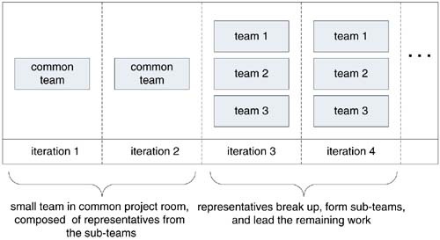
Multi-team Management
Is there any way to partition the project?

Slide 112



Team Assessment
Meeting minutes

Slide 113
The McKinsey 7S Framework [11]
How do you go about analyzing how well your organization is positioned to achieve its intended objective?
While some models of organizational effectiveness go in and out of fashion, one that has persisted is the McKinsey 7S framework.
Developed in the early 1980s by Tom Peters and Robert Waterman, two consultants working at the McKinsey & Company consulting firm.
The basic premise of the model is that there are seven internal aspects of an organization that need to be aligned if it is to be successful.

Slide 114
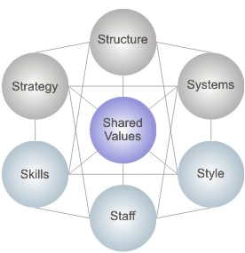
The Seven Elements
Strategy: the plan devised to maintain and build competitive advantage over the competition.
Structure: the way the organization is structured and who reports to whom.
Systems: the daily activities and procedures that staff members engage in to get the job done.
Shared Values: called "super-ordinate goals" when the model was first developed, these are the core values of the company that are evidenced in the corporate culture and the general work ethic.
Style: the style of leadership adopted.
Staff: the employees and their general capabilities.
Skills: the actual skills and competencies of the employees working for the company.

Slide 116
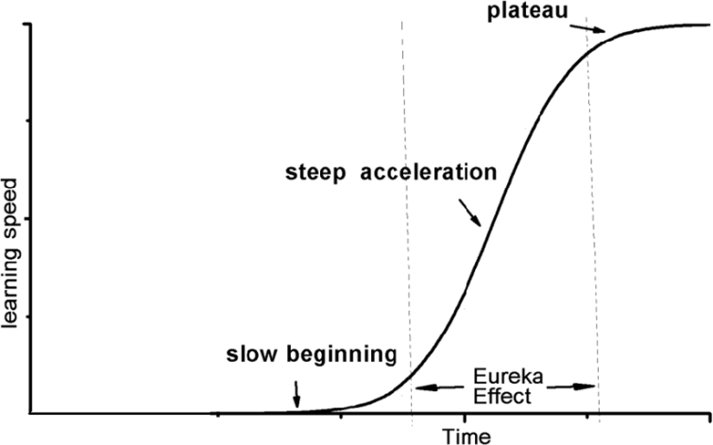
Key Takeaways
Theory X.
Theory Y.
Theory Z.
→ Shared Values / Objectives.
→ Team of Friends.
Spanish Theory → Working Harder → Overtime.
English Theory → Working Smarter.
→ Innovation / Creativity / Technology
- GitLab / CircleCI.
- Docker / Kubernetes.
- Automation Tests.
→ Time Reduction.
→ Steep Learning Curve (Initial Difficulty).
Motivation/Leadership.
→ Needs.
→ Other Theories.
Performance.
→ KPIs.

Slide 118

Further Reading
Lyssa Adkins (2010). Coaching Agile Teams. Addison-Wesley.
Zachary Wong (2007). Human Factors in Project Management - Concepts, Tools, and Techniques for Inspiring Teamwork and Motivation. Jossey-Bass.

Slide 119

Thank You & See You Again

